Slide 1
Today
Have a look at G(T,P) thermodynamic surfaces
Gibbs energy and the 2nd Law
Connect intersecting G(T,P) thermodynamic surfaces to phase equilibria and the Clapeyron equation
Touch on the thermodynamics of combustion and climate change

Slide 2
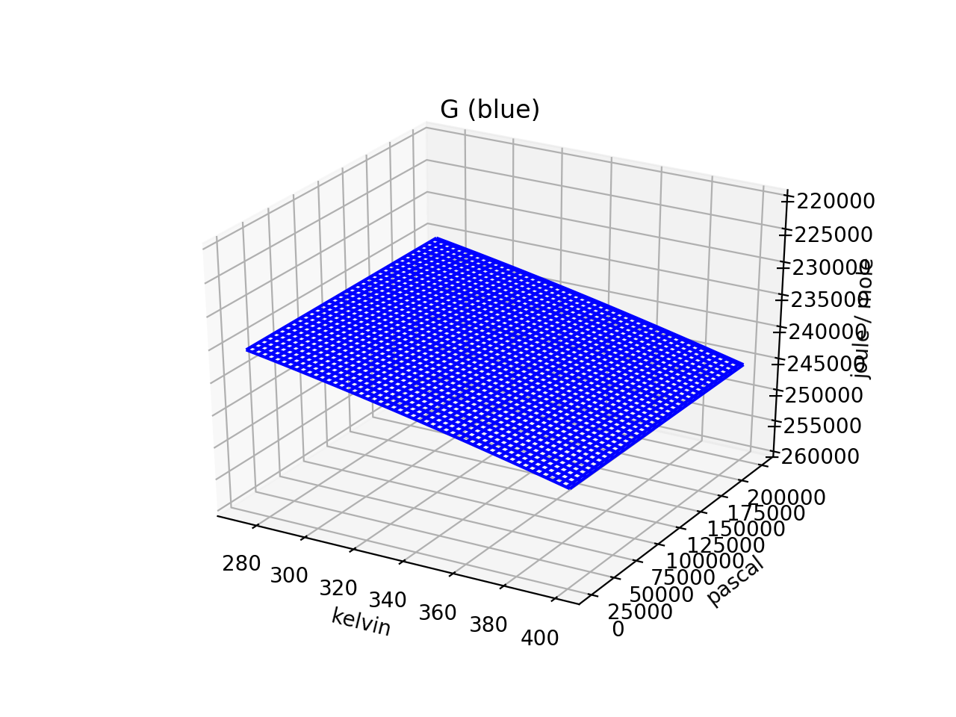
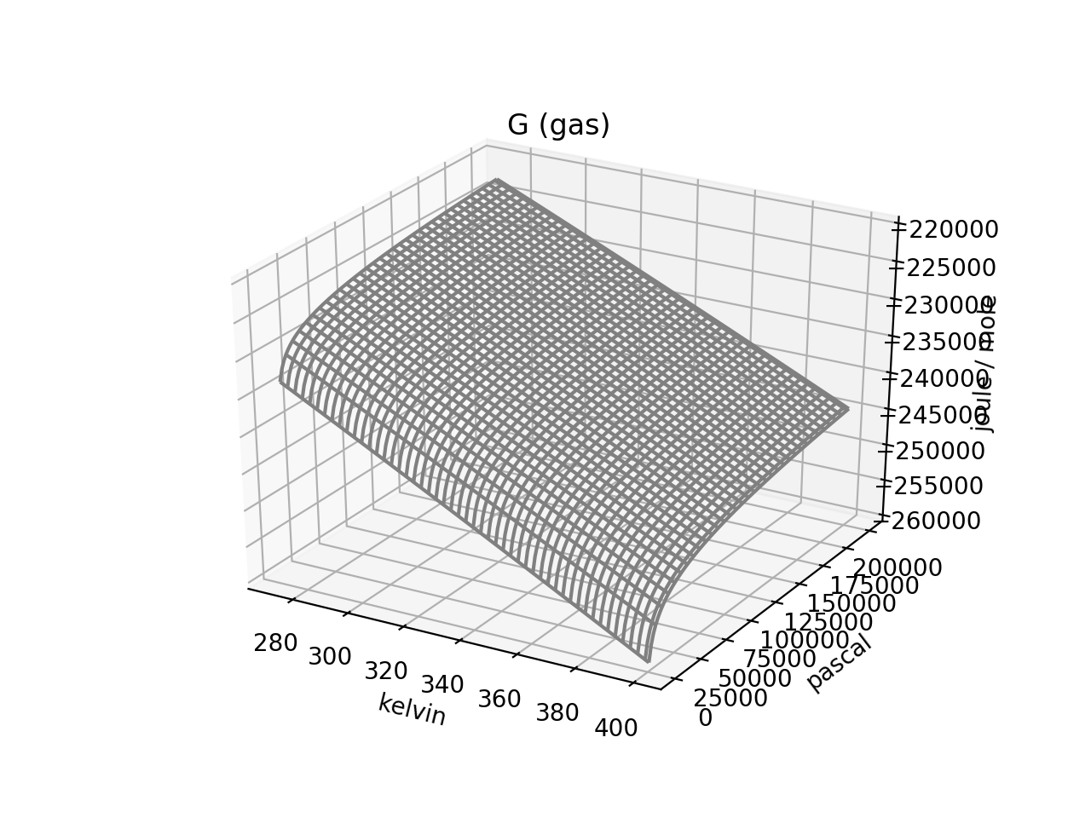

1. G(T,P) thermodynamic surfaces
$$dG=−SdT+VdP$$
Why is the gas curve steeper in the temperature direction?

Slide 3

1. G(T,P) thermodynamic surfaces
$$dG=−SdT+VdP$$
Why is the gas curve steeper in the temperature direction?
Because $S_{gas}>S_{liq}$

Slide 4
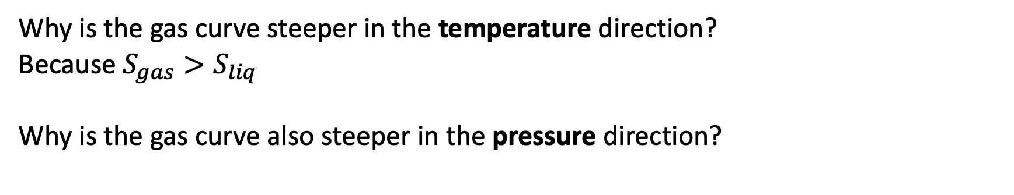
1. G(T,P) thermodynamic surfaces
$$dG=−SdT+VdP$$
Why is the gas curve steeper in the temperature direction?
Because $S_{gas}>S_{liq}$
Why is the gas curve also steeper in the pressure direction?

Slide 5
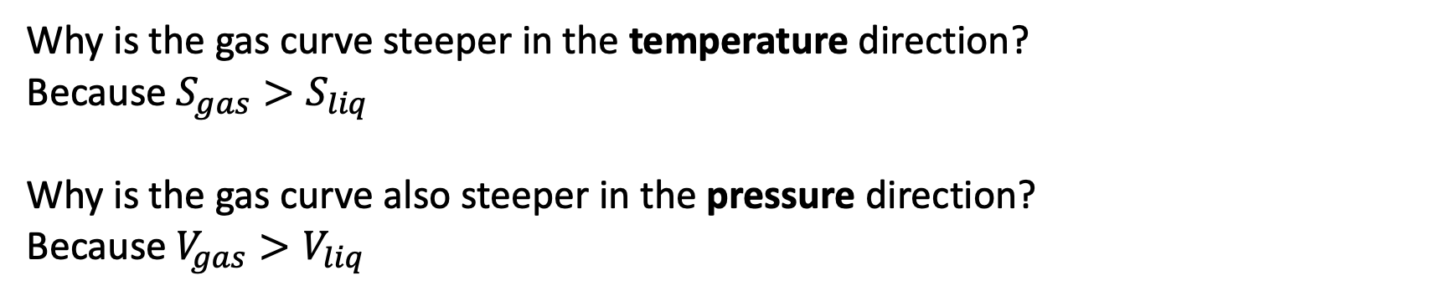
1. G(T,P) thermodynamic surfaces
$$dG=−SdT+VdP$$
Why is the gas curve steeper in the temperature direction?
Because $S_{gas}>S_{liq}$
Why is the gas curve also steeper in the pressure direction?
Because $V_{gas}>V_{liq}$

Slide 6

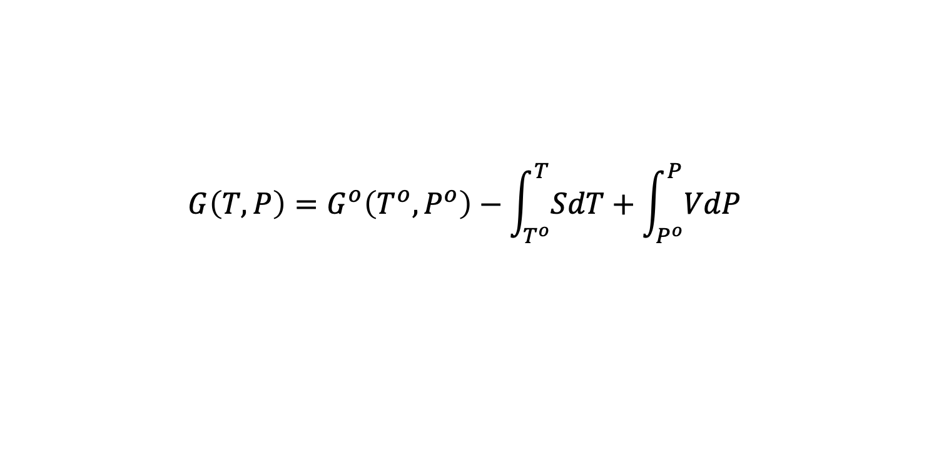
1. G(T,P) thermodynamic surfaces
$$dG=−SdT+VdP$$
$$G\left(T,P\right)=G^{o}\left(T^{o},P^{o}\right)−\int_{T^{o}}^{T}{SdT}+\int_{P^{o}}^{P}{VdP}$$
See: https://en.wikipedia.org/wiki/Standard_Gibbs_free_energy_of_formation

Slide 7
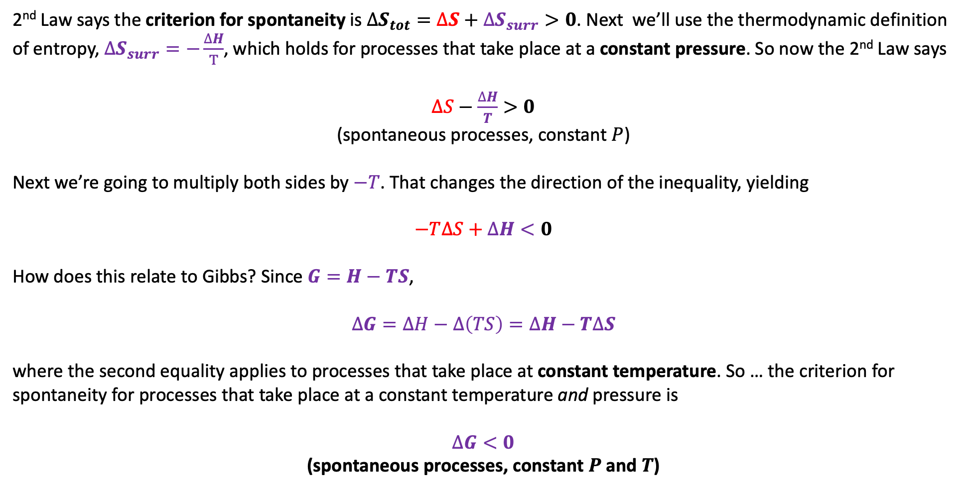
2. G(T,P) thermodynamic surfaces and the 2nd Law
2nd Law says the criterion for spontaneity is $∆S_{tot}=∆S+∆S_{surr}>0$. Next we’ll use the thermodynamic definition of entropy, $∆S_{surr}=−\frac{∆H}{T}$, which holds for processes that take place at a constant pressure. So now the 2nd Law says
$∆S−\frac{∆H}{T}>0$
(spontaneous processes, constant $P$)
Next we’re going to multiply both sides by $−T$. That changes the direction of the inequality, yielding
$$−T∆S+∆H<0$$
How does this relate to Gibbs? Since $G=H−TS$,
$$∆G=∆H−∆\left(TS\right)=∆H−T∆S$$
where the second equality applies to processes that take place at constant temperature. So … the criterion for spontaneity for processes that take place at a constant temperature and pressure is
$∆G<0$
(spontaneous processes, constant $P$ and $T$)

Slide 8
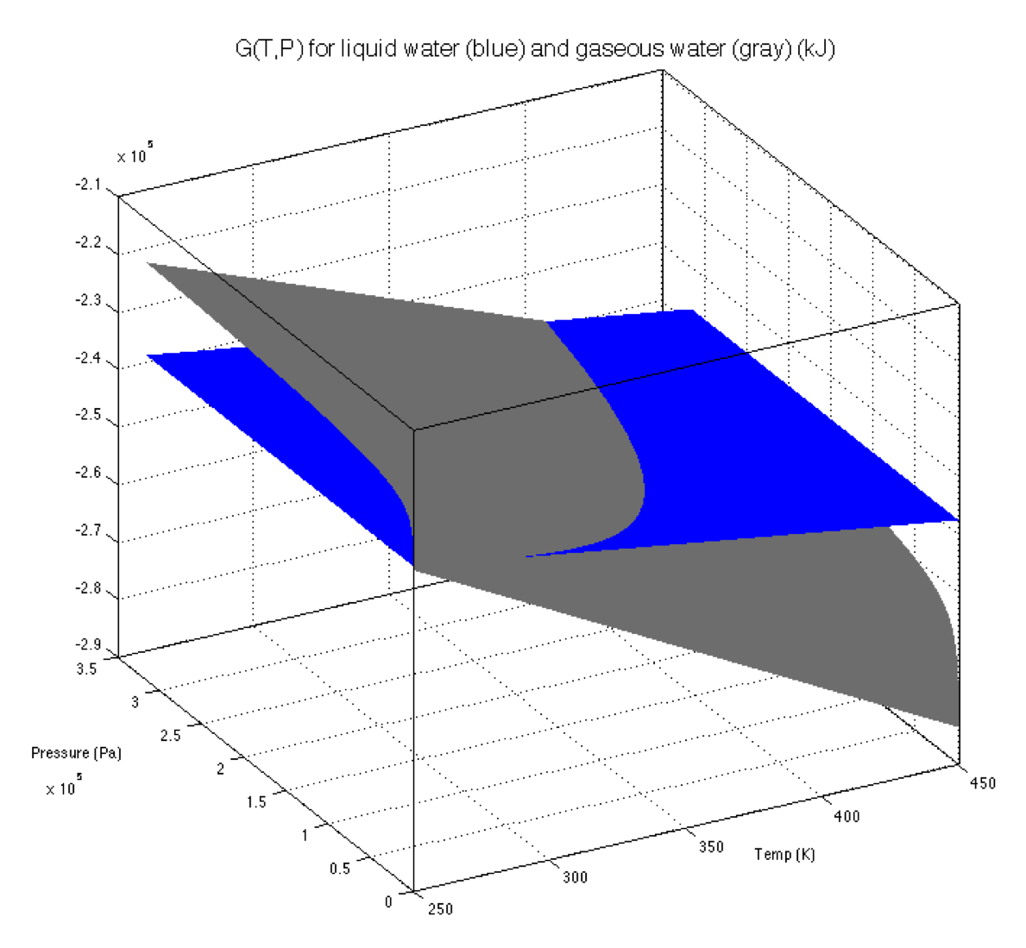
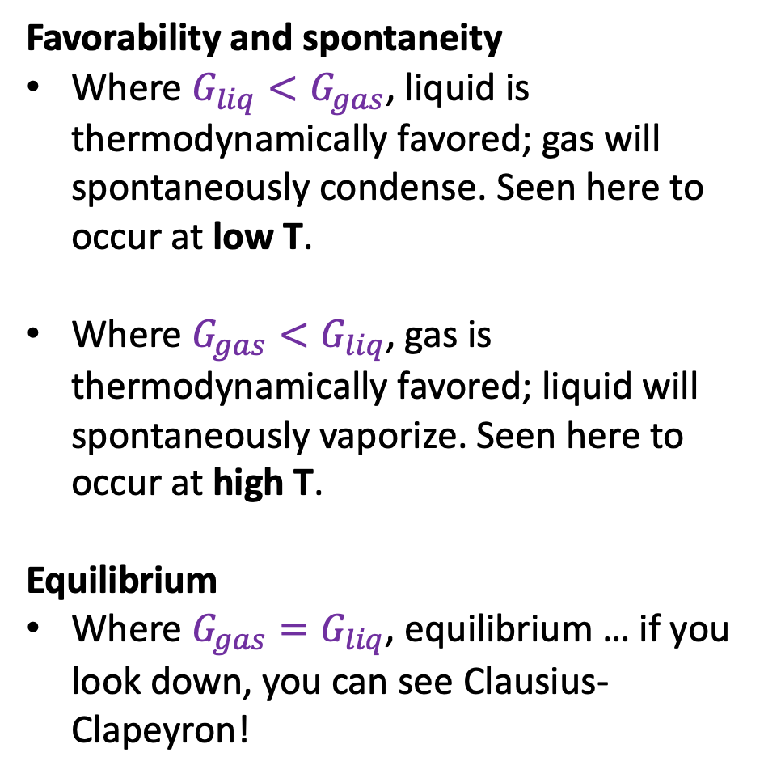
2. G(T,P) thermodynamic surfaces and the 2nd Law
Favorability and spontaneity
Where $G_{liq}<G_{gas}$, liquid is thermodynamically favored; gas will spontaneously condense. Seen here to occur at low T.
Where $G_{gas}<G_{liq}$, gas is thermodynamically favored; liquid will spontaneously vaporize. Seen here to occur at high T.
Equilibrium
Where $G_{gas}=G_{liq}$, equilibrium … if you look down, you can see Clausius-Clapeyron!

Slide 9
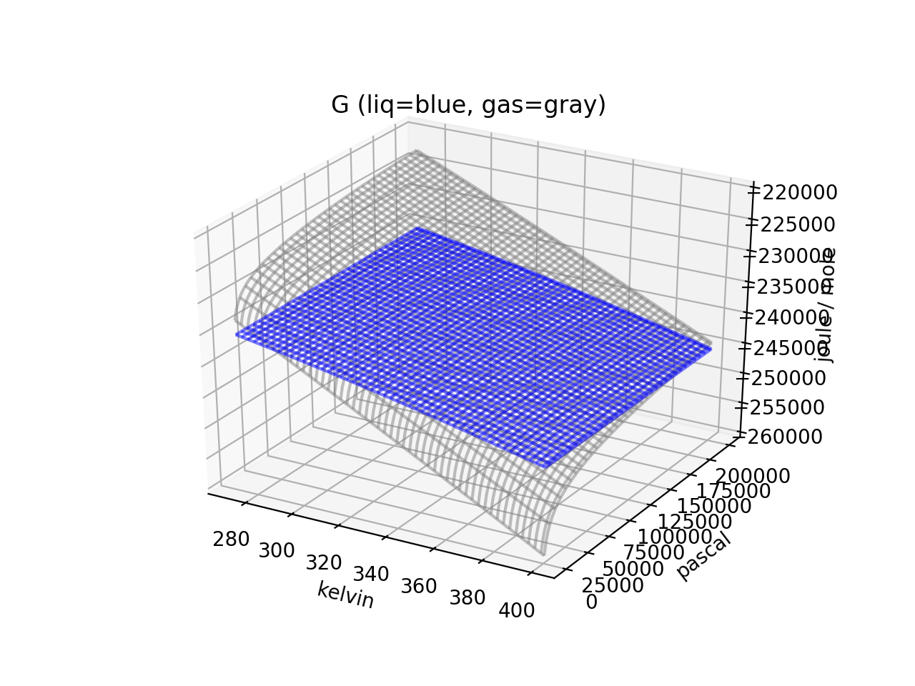
3. Connection to Clapeyron and Clausius-Clapeyron (phase diagrams)
Hopefully this is easier to see in Python

Slide 10
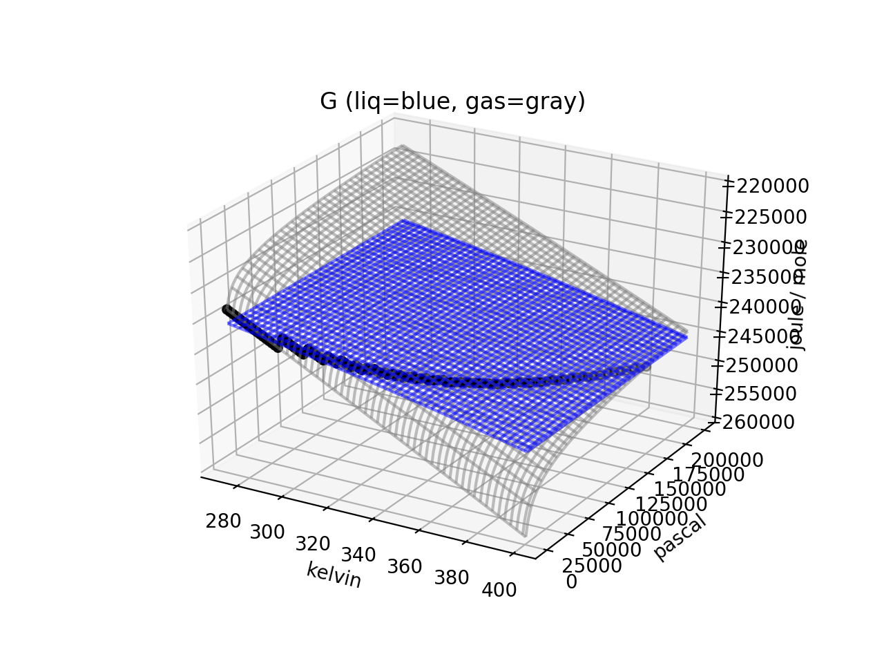
3. Connection to Clapeyron and Clausius-Clapeyron (phase diagrams)
Hopefully this is easier to see in Python

Slide 11
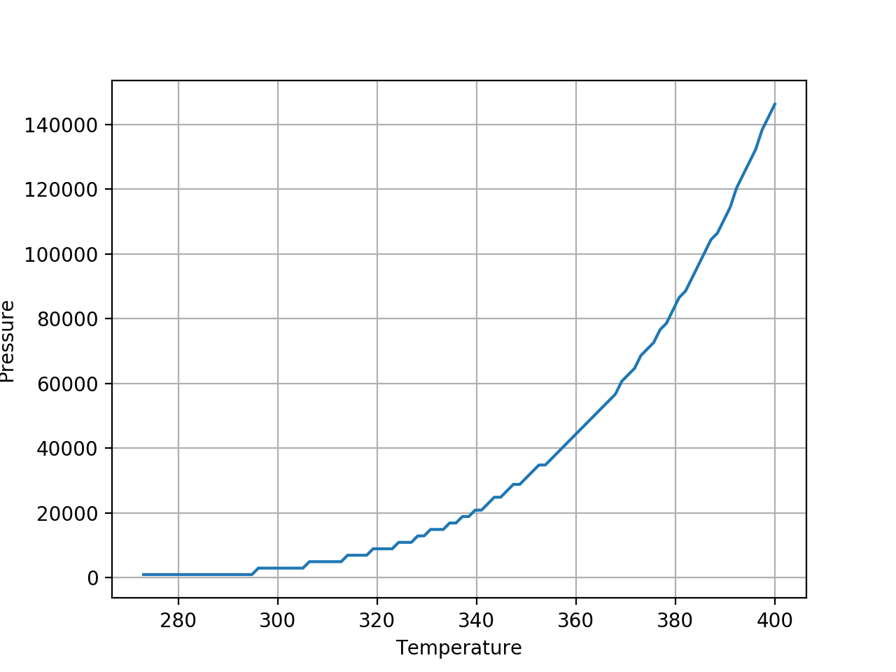
3. Connection to Clapeyron and Clausius-Clapeyron (phase diagrams)

Slide 12

3. Connection to Clapeyron and Clausius-Clapeyron (phase diagrams)
Let’s say points A and B both correspond to equilibrium between gas and liquid. Going from A to B, the Gibbs energy of each might change,
$dG_{gas}=−S_{gas}dT+V_{gas}dP$
$dG_{liq}=−S_{liq}dT+V_{liq}dP$
But they have to change the same amount to remain in equilibrium! So $dG_{gas}=dG_{liq}$ in going from A to B. That means
$$\frac{dP}{dT}=\frac{∆S_{vap}}{∆V_{vap}}=−\frac{∆H_{vap}}{T ∆V_{vap}}$$
Clapeyron!!
A
B

Slide 13


4. Gibbs energy of burning a mole of coal: the benefit
Goal: Find $∆G=∆G_{rxn}^{o}+∆G_{dil}$ for $C\left(s\right)+O_{2}\left(g\right)→CO_{2}\left(g\right)$.
Benefit:
Heat fuels an electricity-generating power plant
Furnace

Slide 14
4. Gibbs energy of burning a mole of coal: the benefit
Goal: Find $∆G=∆G_{rxn}^{o}+∆G_{dil}$ for $C\left(s\right)+O_{2}\left(g\right)→CO_{2}\left(g\right)$.
Benefit:
Heat fuels an electricity-generating power plant
Furnace

Slide 15
4. Gibbs energy of burning a mole of coal: the benefit
Goal: Find $∆G=∆G_{rxn}^{o}+∆G_{dil}$ for $C\left(s\right)+O_{2}\left(g\right)→CO_{2}\left(g\right)$.
Benefit:
Heat fuels an electricity-generating power plant
Although only about 40% gets turned into useful electrical energy
Furnace

Slide 16
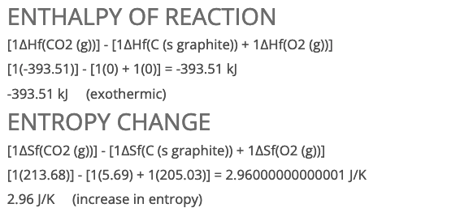
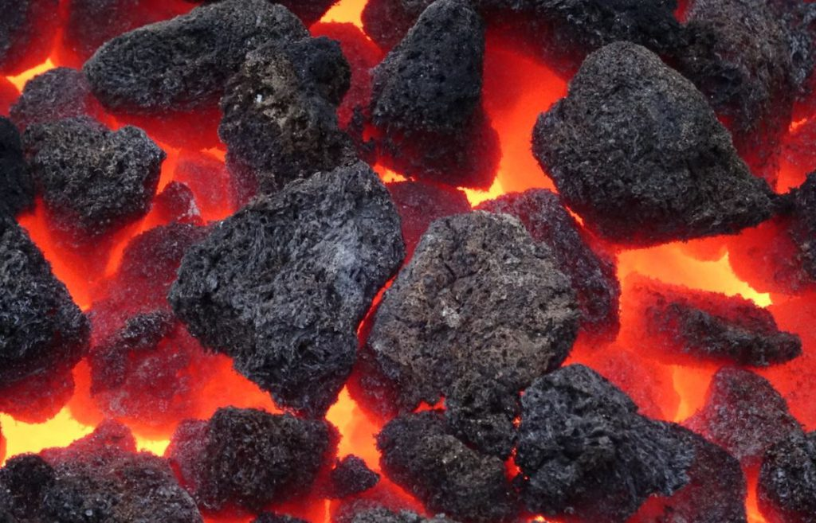
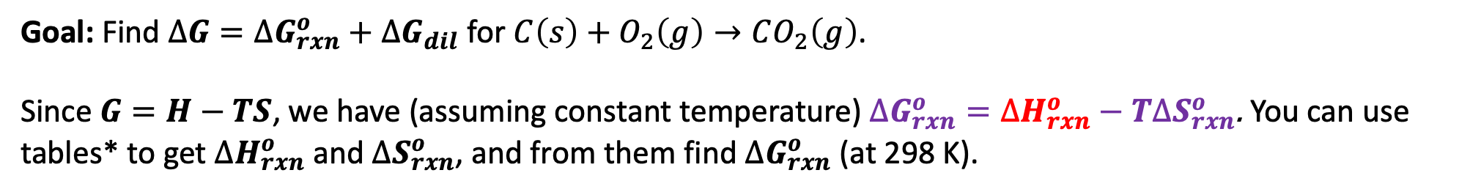
4. Gibbs energy of burning a mole of coal: in the furnace
Goal: Find $∆G=∆G_{rxn}^{o}+∆G_{dil}$ for $C\left(s\right)+O_{2}\left(g\right)→CO_{2}\left(g\right)$.
Since $G=H−TS$, we have (assuming constant temperature) $∆G_{rxn}^{o}=∆H_{rxn}^{o}−T∆S_{rxn}^{o}$. You can use tables* to get $∆H_{rxn}^{o}$ and $∆S_{rxn}^{o}$, and from them find $∆G_{rxn}^{o}$ (at 298 K).
*http://chemistry-reference.com/reaction.asp?rxnnum=100

Slide 17
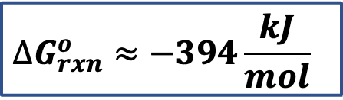
4. Gibbs energy of burning a mole of coal: in the furnace
Goal: Find $∆G=∆G_{rxn}^{o}+∆G_{dil}$ for $C\left(s\right)+O_{2}\left(g\right)→CO_{2}\left(g\right)$.
Since $G=H−TS$, we have (assuming constant temperature) $∆G_{rxn}^{o}=∆H_{rxn}^{o}−T∆S_{rxn}^{o}$. You can use tables* to get $∆H_{rxn}^{o}$ and $∆S_{rxn}^{o}$, and from them find $∆G_{rxn}^{o}$ (at 298 K).
$$∆G_{rxn}^{o}≈−394\frac{kJ}{mol}$$
*http://chemistry-reference.com/reaction.asp?rxnnum=100

Slide 18
4. Gibbs energy of burning a mole of coal: in the furnace
Goal: Find $∆G=∆G_{rxn}^{o}+∆G_{dil}$ for $C\left(s\right)+O_{2}\left(g\right)→CO_{2}\left(g\right)$.
Since $G=H−TS$, we have (assuming constant temperature) $∆G_{rxn}^{o}=∆H_{rxn}^{o}−T∆S_{rxn}^{o}$. You can use tables* to get $∆H_{rxn}^{o}$ and $∆S_{rxn}^{o}$, and from them find $∆G_{rxn}^{o}$ (at 298 K).
$$∆G_{rxn}^{o}≈−394\frac{kJ}{mol}$$
*http://chemistry-reference.com/reaction.asp?rxnnum=100

Slide 19
4. Gibbs energy of burning a mole of coal: the benefit
Goal: Find $∆G=∆G_{rxn}^{o}+∆G_{dil}$ for $C\left(s\right)+O_{2}\left(g\right)→CO_{2}\left(g\right)$.
Benefit:
Heat fuels an electricity-generating power plant
Remember that only about 40% gets turned into useful electrical energy
394 kJ/mol heat
160 kJ/mol electrical energy
Furnace

Slide 20
4. Gibbs energy of burning a mole of coal: the benefit
Goal: Find $∆G=∆G_{rxn}^{o}+∆G_{dil}$ for $C\left(s\right)+O_{2}\left(g\right)→CO_{2}\left(g\right)$.
Benefit:
Heat fuels an electricity-generating power plant
Remember that only about 40% gets turned into useful electrical energy
394 kJ/mol heat
160 kJ/mol electrical energy
Furnace

Slide 21



4. Gibbs energy of burning a mole of coal: the cost
Goal: Find $∆G=∆G_{rxn}^{o}+∆G_{dil}$ for $C\left(s\right)+O_{2}\left(g\right)→CO_{2}\left(g\right)$.
Cost: $CO_{2}\left(g\right)$ as a trace gas in Earth’s atmosphere warms the planet
$$V_{final}=4.2 x {10}^{18} m^{3}$$
Furnace

Slide 22


4. Gibbs energy of burning a mole of coal: the cost
Goal: Find $∆G=∆G_{rxn}^{o}+∆G_{dil}$ for $C\left(s\right)+O_{2}\left(g\right)→CO_{2}\left(g\right)$.
Cost: $CO_{2}\left(g\right)$ as a trace gas in Earth’s atmosphere warms the planet
$$V_{final}=4.2 x {10}^{18} m^{3}$$
$$∆S_{dil}=R\ln{(\frac{V_{final}}{V_{initial}})}$$
$V_{initial}=\frac{RT}{P}≈24 L$
Furnace

Slide 23
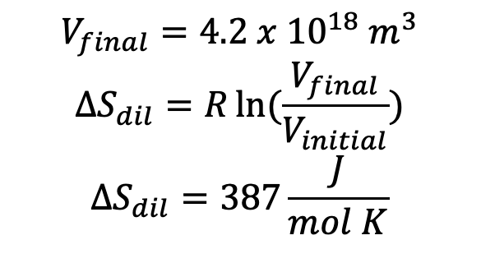
4. Gibbs energy of burning a mole of coal: the cost
Goal: Find $∆G=∆G_{rxn}^{o}+∆G_{dil}$ for $C\left(s\right)+O_{2}\left(g\right)→CO_{2}\left(g\right)$.
Cost: $CO_{2}\left(g\right)$ as a trace gas in Earth’s atmosphere warms the planet
$$V_{final}=4.2 x {10}^{18} m^{3}$$
$$∆S_{dil}=R\ln{(\frac{V_{final}}{V_{initial}})}$$
$$∆S_{dil}=387\frac{J}{mol K}$$
$V_{initial}=\frac{RT}{P}≈24 L$
Furnace

Slide 24

4. Gibbs energy of burning a mole of coal: the cost
Goal: Find $∆G=∆G_{rxn}^{o}+∆G_{dil}$ for $C\left(s\right)+O_{2}\left(g\right)→CO_{2}\left(g\right)$.
Cost: $CO_{2}\left(g\right)$ as a trace gas in Earth’s atmosphere warms the planet
$$V_{final}=4.2 x {10}^{18} m^{3}$$
$$∆S_{dil}=R\ln{(\frac{V_{final}}{V_{initial}})}$$
$$∆S_{dil}=387\frac{J}{mol K}$$
$$∆G_{dil}=−115\frac{kJ}{mol}$$
$V_{initial}=\frac{RT}{P}≈24 L$
Furnace

Slide 25
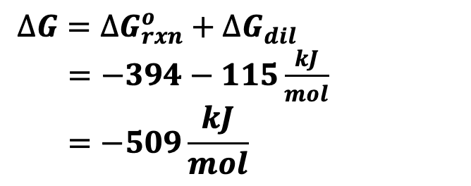
4. Gibbs energy of burning a mole of coal: the cost
Goal: Find $∆G=∆G_{rxn}^{o}+∆G_{dil}$ for $C\left(s\right)+O_{2}\left(g\right)→CO_{2}\left(g\right)$.
Cost: $CO_{2}\left(g\right)$ as a trace gas in Earth’s atmosphere warms the planet
$$V_{final}=4.2 x {10}^{18} m^{3}$$
$$∆S_{dil}=R\ln{(\frac{V_{final}}{V_{initial}})}$$
$$∆S_{dil}=387\frac{J}{mol K}$$
$$∆G_{dil}=−115\frac{kJ}{mol}$$
$V_{initial}=\frac{RT}{P}≈24 L$
$∆G=∆G_{rxn}^{o}+∆G_{dil}$
$=−394−115\frac{kJ}{mol}$
$$=−509\frac{kJ}{mol}$$
Furnace

Slide 26
4. Gibbs energy of burning a mole of coal: the cost
Goal: Find $∆G=∆G_{rxn}^{o}+∆G_{dil}$ for $C\left(s\right)+O_{2}\left(g\right)→CO_{2}\left(g\right)$.
Cost: $CO_{2}\left(g\right)$ as a trace gas in Earth’s atmosphere warms the planet
$$V_{final}=4.2 x {10}^{18} m^{3}$$
$$∆S_{dil}=R\ln{(\frac{V_{final}}{V_{initial}})}$$
$$∆S_{dil}=387\frac{J}{mol K}$$
$$∆G_{dil}=−115\frac{kJ}{mol}$$
$V_{initial}=\frac{RT}{P}≈24 L$
$∆G=∆G_{rxn}^{o}+∆G_{dil}$
$=−394−115\frac{kJ}{mol}$
$$=−509\frac{kJ}{mol}$$
Furnace

Slide 27

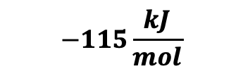
4. Gibbs energy of burning a mole of coal: the cost
Goal: Find $∆G=∆G_{rxn}^{o}+∆G_{dil}$ for $C\left(s\right)+O_{2}\left(g\right)→CO_{2}\left(g\right)$.
Cost: $CO_{2}\left(g\right)$ as a trace gas in Earth’s atmosphere warms the planet
$$V_{final}=4.2 x {10}^{18} m^{3}$$
$V_{initial}=\frac{RT}{P}≈24 L$
$$−115\frac{kJ}{mol}$$
Furnace

Slide 28
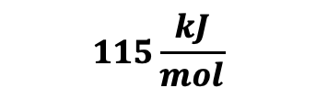
4. Gibbs energy of burning a mole of coal: the cost
Goal: Find $∆G=∆G_{rxn}^{o}+∆G_{dil}$ for $C\left(s\right)+O_{2}\left(g\right)→CO_{2}\left(g\right)$.
Cost: $CO_{2}\left(g\right)$ as a trace gas in Earth’s atmosphere warms the planet
$$V_{final}=4.2 x {10}^{18} m^{3}$$
$V_{initial}=\frac{RT}{P}≈24 L$
Cost to somebody in the future
$$115\frac{kJ}{mol}$$
Furnace

Slide 29
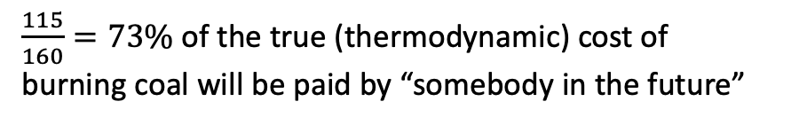
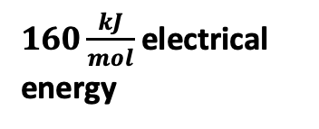
4. Gibbs energy of burning a mole of coal: the cost
Goal: Find $∆G=∆G_{rxn}^{o}+∆G_{dil}$ for $C\left(s\right)+O_{2}\left(g\right)→CO_{2}\left(g\right)$.
Cost: $CO_{2}\left(g\right)$ as a trace gas in Earth’s atmosphere warms the planet
$$V_{final}=4.2 x {10}^{18} m^{3}$$
$V_{initial}=\frac{RT}{P}≈24 L$
Cost to somebody in the future
Benefit to us in the present
$$115\frac{kJ}{mol}$$
$160\frac{kJ}{mol}$electrical energy
Furnace
$\frac{115}{160}=73\%$ of the true (thermodynamic) cost of burning coal will be paid by “somebody in the future”

